Slide 1
Deploying MiroTalk C2C
A complete, step-by-step guide to deploying a self-hosted peer-to-peer video conferencing server — using Proxmox VE, Ubuntu, Docker, and Containerlab.

Slide 2




The Technology Stack
Four components work together to deliver a fully isolated, reproducible video conferencing environment.
Proxmox VE
Ubuntu VM
Hypervisor layer for creating and managing Ubuntu virtual machines.
The host OS running all containers — clean, minimal, and fully updated.
Docker
Containerlab
Container runtime that isolates MiroTalk and its dependencies.
Topology orchestrator that defines and deploys the virtual network lab.

Slide 3



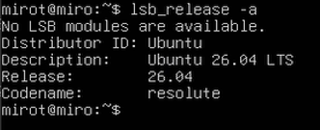
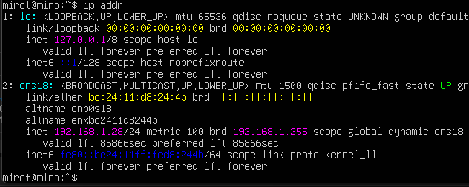
Verify & Update the Ubuntu VM
Before installing any tooling, bring the VM up to date and confirm its network identity.
Update package lists
sudo apt update
Upgrade all packages
sudo apt upgrade -y
Verify OS release
lsb_release -a
Check network interfaces
ip addr

Slide 4
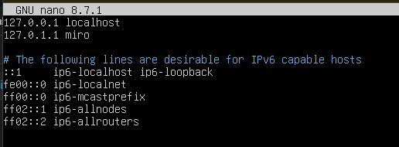
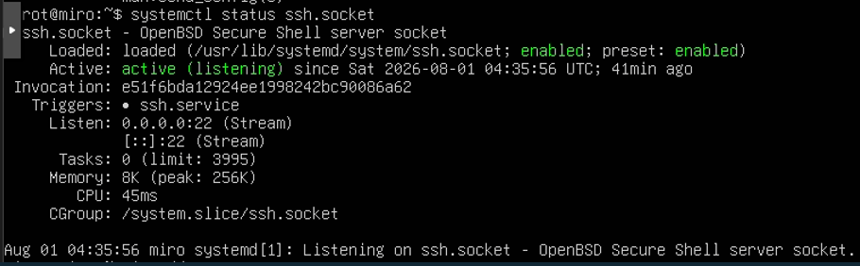
Give the Server a Hostname
Edit host file
$ sudo nano /etc/hosts
packages
Systemctl status ssh.socket

Slide 5
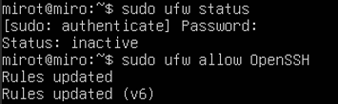




Allow Requird ports
Allow HTTP
$ sudo ufw allow 80/tcp
Allow HTTPS
$ sudo ufw allow 443/tcp
Allow UDP
$ sudo ufw allow 10000/udp
Enable firewall
$ sudo ufw enable

Slide 6
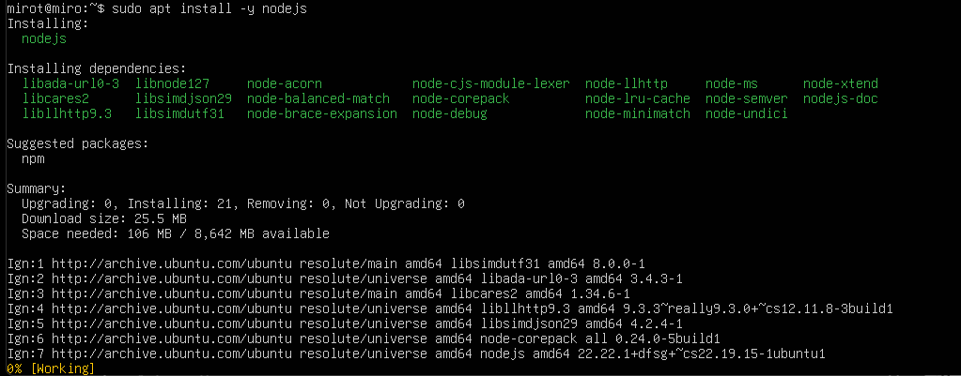
Install NodeJS
sudo apt install -y nodejs

Slide 7
Install MiroTalk C2C
git clone https://github.com/miroslavpejic85/mirotalkc2c.git
Enter the project directory
cd mirotalkc2c

Slide 8
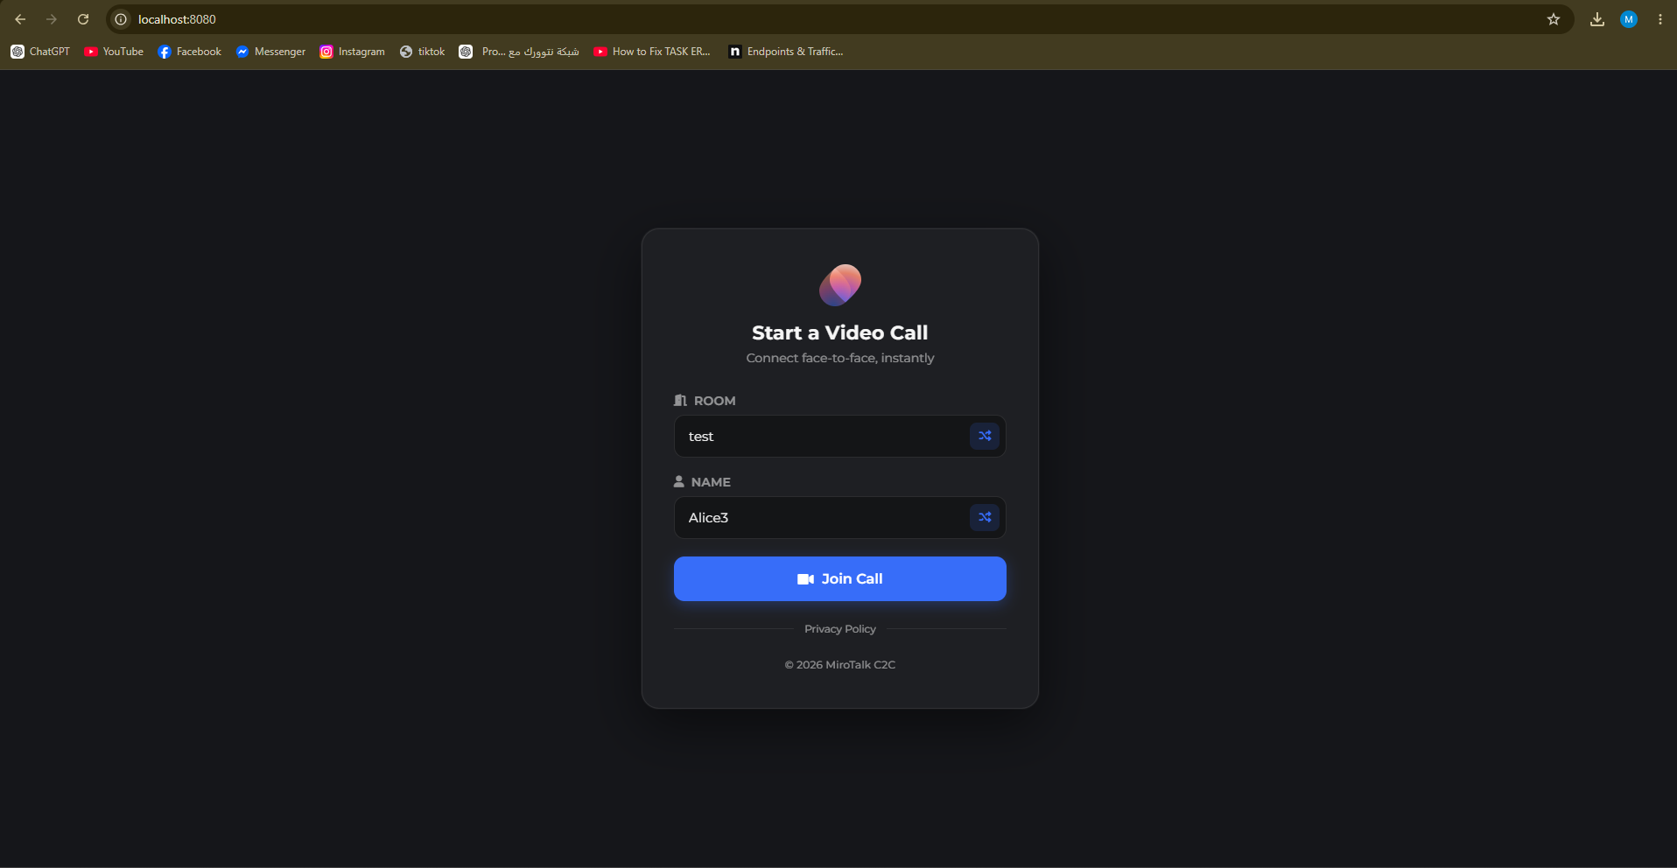

Slide 9
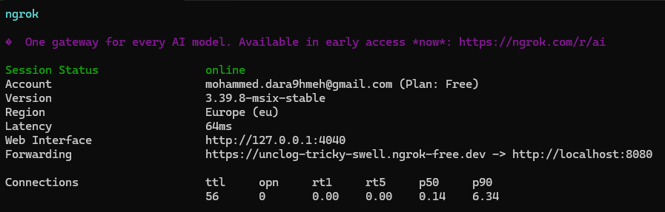
Create a Public Link Using Ngrok:

Slide 10
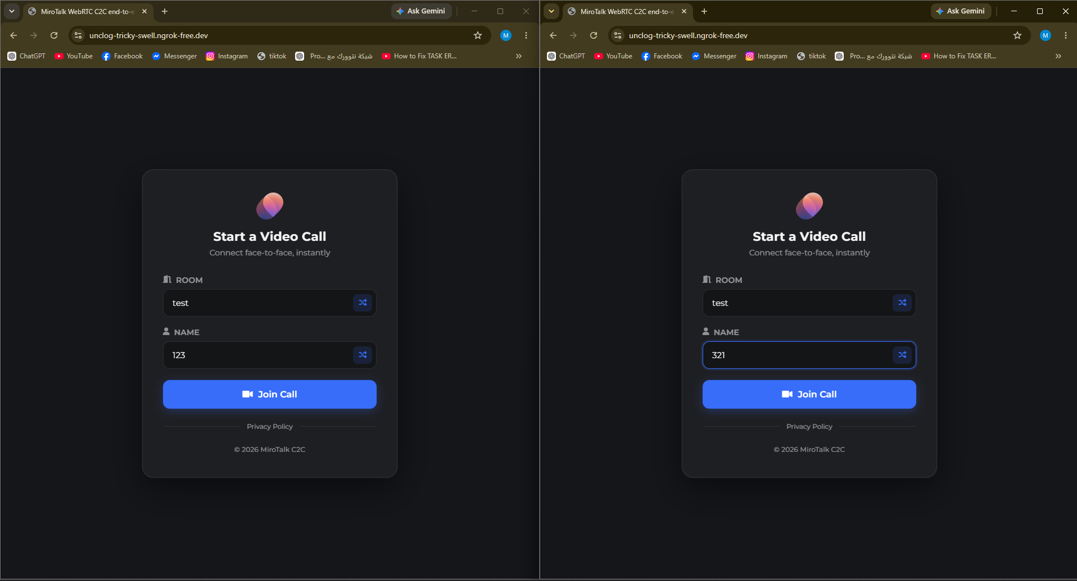

Slide 11
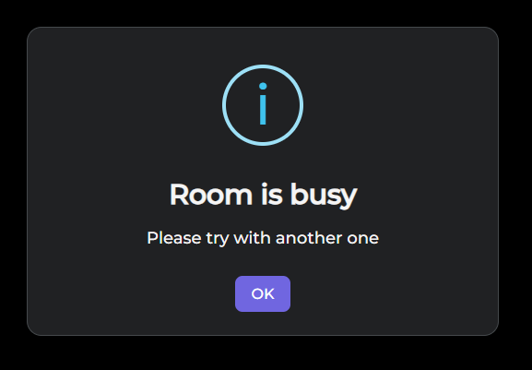

Slide 12
Create the Network Topology
The lab.clab.yml file is the blueprint for your entire lab. It defines two nodes — a router and a server — connected over a virtual Ethernet link.
name: mirotalk-project
topology:
nodes:
router:
kind: linux
image: ubuntu:24.04
server:
kind: linux
image: ubuntu:24.04
links:
- endpoints:[ router:eth1,server:eth1]

